Slide 1
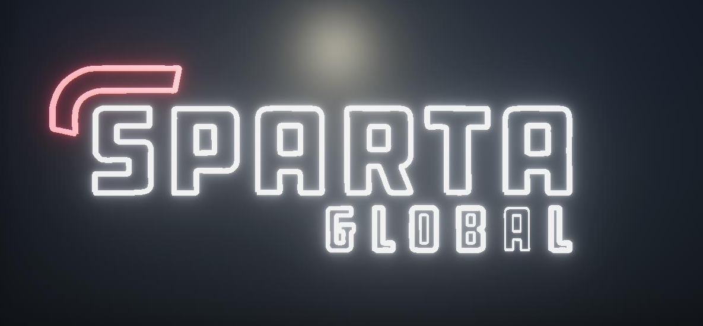

Sparta Simulation Project
Miguel António Fernandes Vieira
Sparta Consultant

Slide 2

Introduction
Software used and workflow
Problems found
Local Multiplayer
Code Highlights

Slide 3
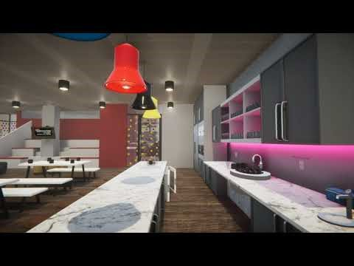

Slide 4

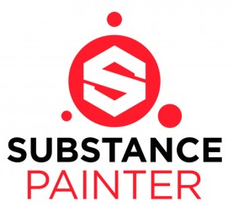

Software and Workflow
3D Modelling:
Autodesk Maya
Texture creation:
Substance Painter
Game Engine:
Unity 3D HDRP (High Def. Render Pipeline)

Slide 5
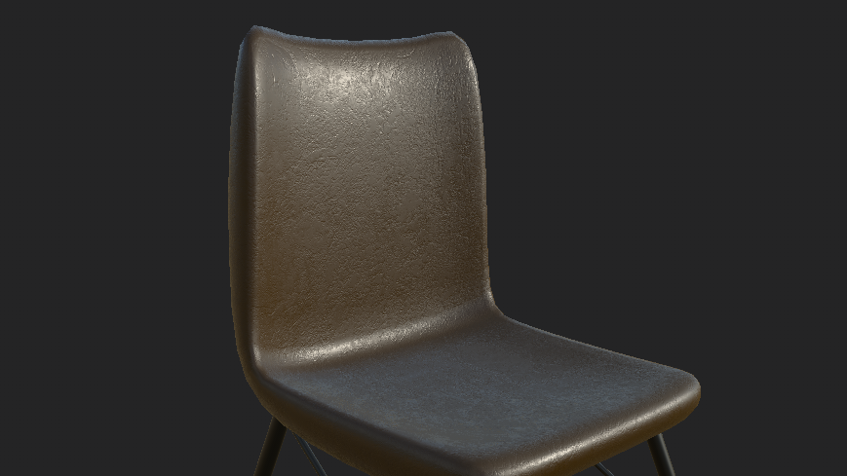
Texture Examples

Slide 6
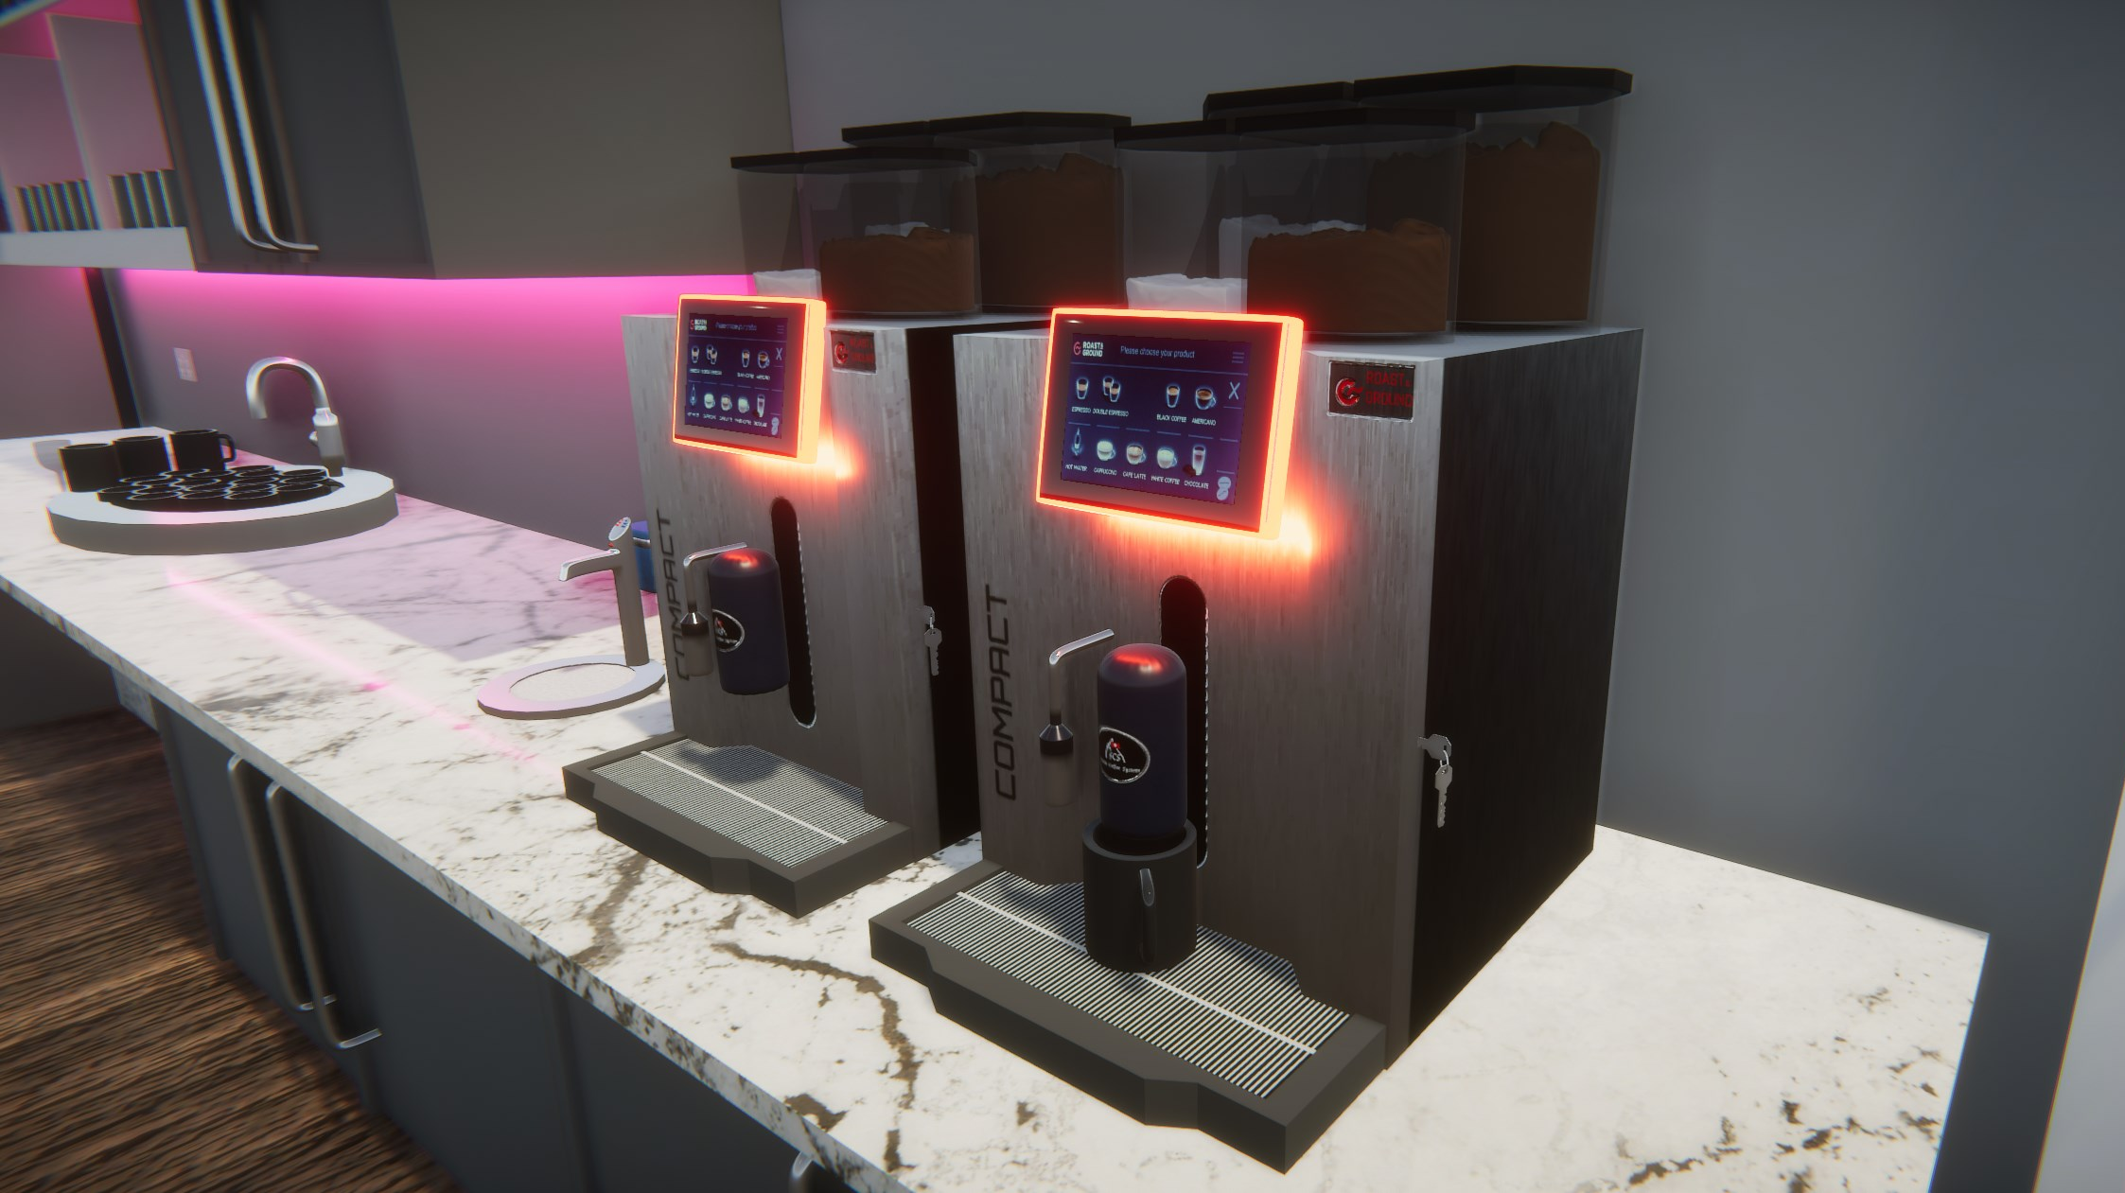

Slide 7
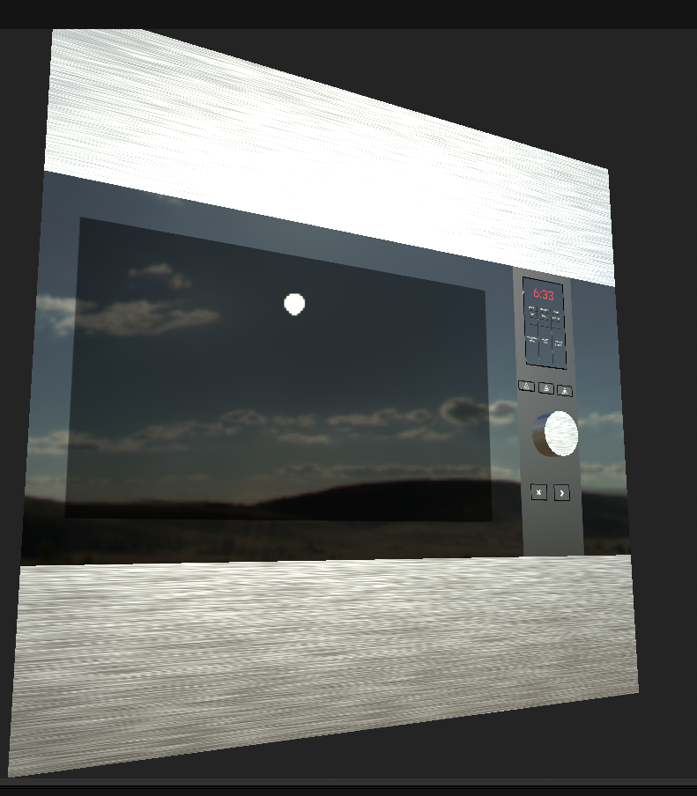

Slide 8
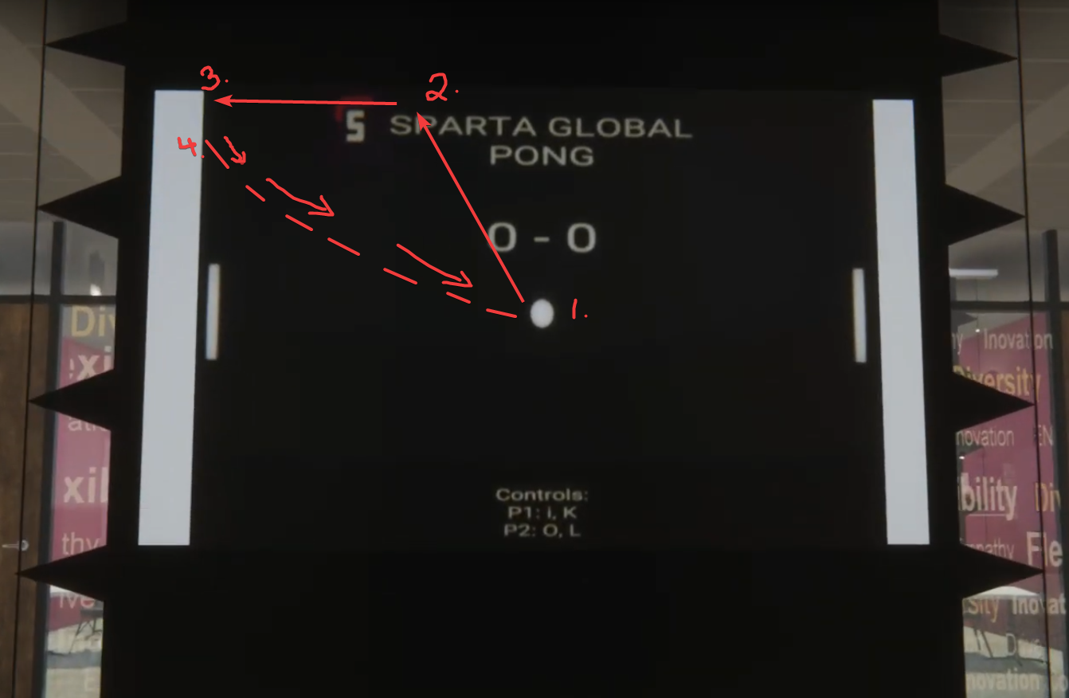
Problems Found
Texture optimization
Lighting:
Shadows on objects
Main sun disk
Score gets called twice and duplicates score
Pong Mini Game:
Ball did not move 45 degrees all the time
RigidBody movement updates 2 times/s while Update(){} does it every frame (movement issue)

Slide 9
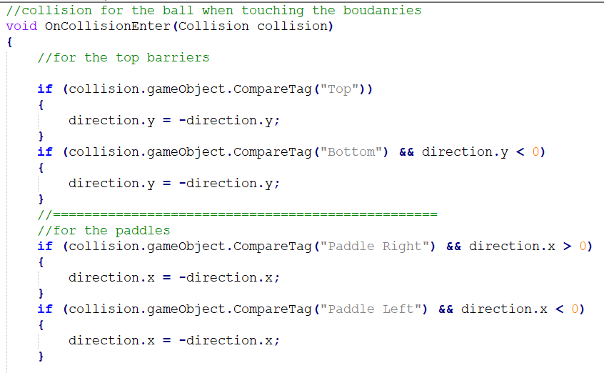
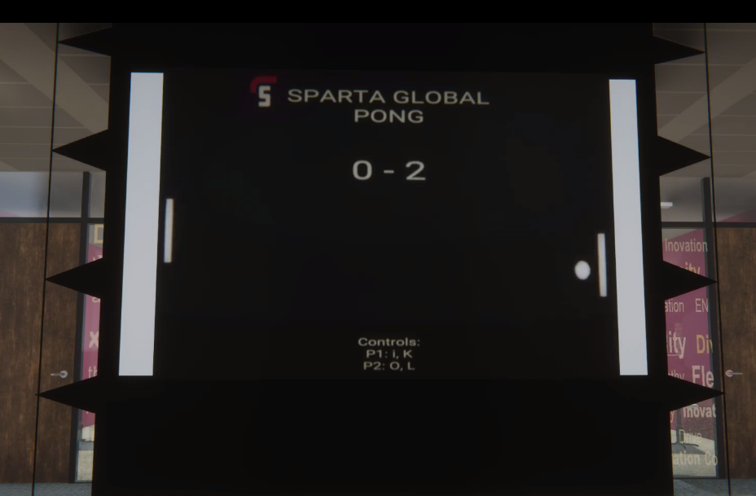
Local Multiplayer Mini Game
Mini game uses a second Camera
Renders live texture
Ball movement:
Uses a Vector(1f,1f,0f)
if(collisions)

Slide 10
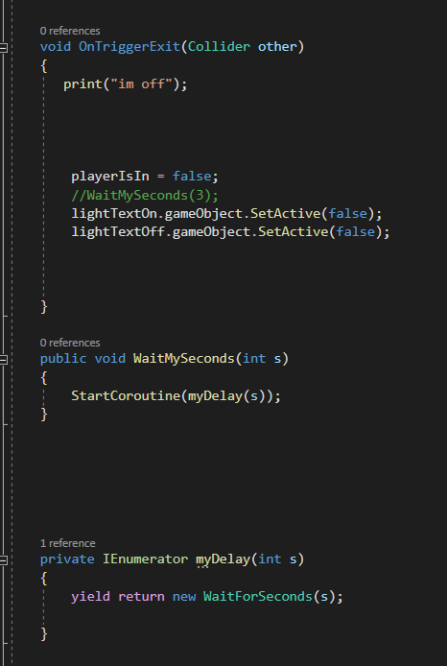
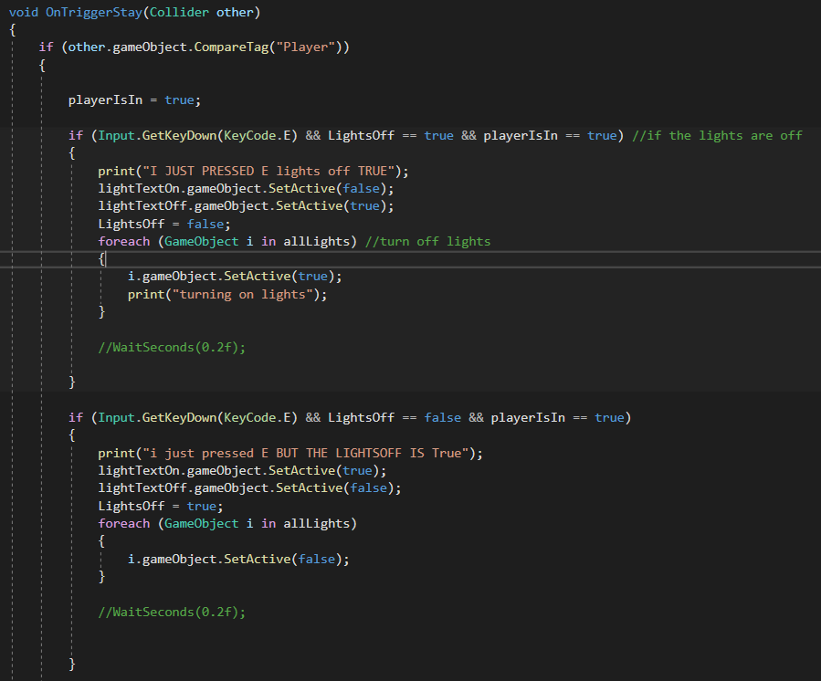
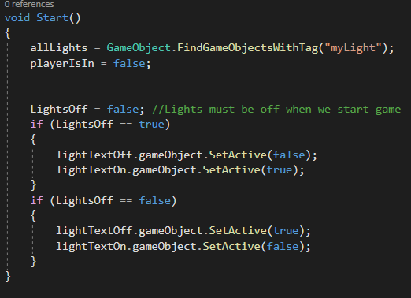
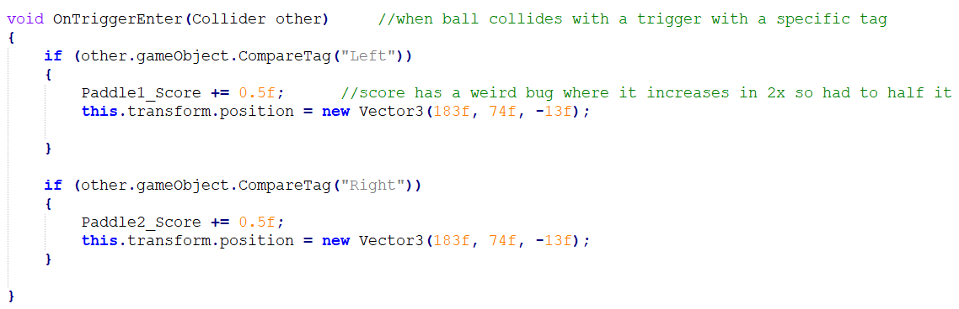
Other Code Highlights

Slide 11
Questions?

